Slide 1

CSA15 | Cloud Computing and Big Data Analytics
CSA1512- Cloud Computing and Big Data Analytics
Presenter Details
Student Name: T. Prakeerthi
Register Number:192524279
Class / Section / Slot: B
Capstone Title: Medi Queue AI: Hospital of Queue and No-show. prediction App.
Selected SDG Goal(s):
Cloud Platform / Tools:
Capstone Cloud Technical Presentation
Individual Student Presentation Deck
Presentation Focus
Present your capstone as a cloud-backed product. Explain the problem, architecture, service choices, evidence, and CO1 learning clearly.
Individual student submission template | Department of Computer Science and Engineering
CO1 AT3 | 01
Notes:
Open by naming the capstone problem and the cloud product objective. Keep the title slide uncluttered and clearly identify the individual presenter.

Slide 2
CSA15 | Cloud Computing and Big Data Analytics
Problem Context and Stakeholder Mapping
Our capstone begins with a real problem to solve
Problem Statement
Target Users
Manual appointment scheduling in hospitals can lead to overcrowded waiting areas and frequent no-shows. Medi Queue AI uses Artificial Intelligence to optimize appointments, predict no-shows, and provide real-time queue updates for better hospital management.
Patients
Doctors
Hospital Receptionists
Hospital Administrators
SDG Fit
Product Boundary
Improves access to quality healthcare.
Reduces patient waiting time.
Predicts and minimizes appointment no-shows.
Patient registration and login
OP appointment booking
AI-based no-show prediction
Smart queue management
Individual student submission template | Department of Computer Science and Engineering
CO1 AT3 | 02
Notes:
Do not start with technology. First make the need clear, then connect it to cloud-enabled scale, reach, or reliability.

Slide 3
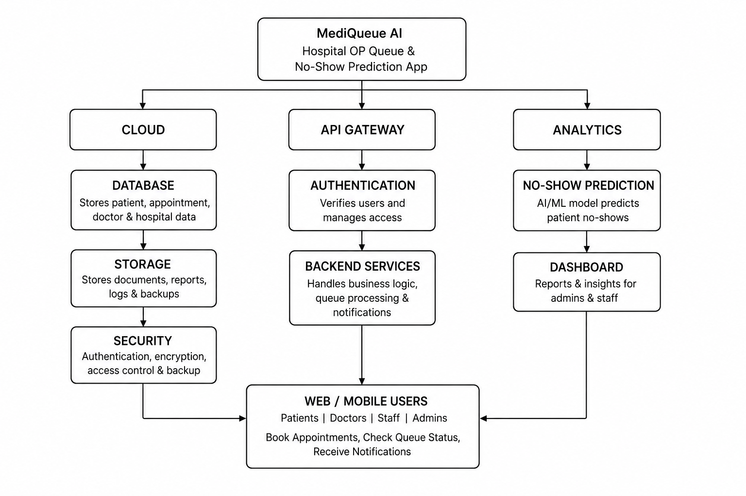
CSA15 | Cloud Computing and Big Data Analytics
Cloud Adoption Rationale and Concept Map
The problem needs cloud support to become a usable product
Cloud Concept Map
Cloud Definition
Cloud computing is the use of internet-based services to store and process data. In MediQueue AI, it manages appointments, predicts no-shows, and updates OP queues in real time.
.
Cloud Characteristics
On-Demand Self-Service – Patients can book appointments anytime.
Broad Network Access – Accessible through mobile apps and web browsers.
Rapid Elasticity – Automatically handles increased patient traffic during busy hours.
.
Individual student submission template | Department of Computer Science and Engineering
CO1 AT3 | 03
Notes:
Students should explain the concept map as a reasoning artifact, not as decoration.

Slide 4
CSA15 | Cloud Computing and Big Data Analytics
Capstone Cloud Architecture
Our cloud architecture connects the user action to services
Scaling point
Presentation Points
Used to book appointments and check queue status.
Verifies users and securely sends requests.
Manages appointments, queues, and notifications.
Stores patient and appointment data safely.
Monitors the system and predicts no-shows.
Automatically handles more users during peak hours.
Protects patient data and ensures secure communication.
User App / Web App
Auth + API Gateway
Backend Services
Database / Storage
Security boundary
Analytics + Monitoring
Individual student submission template | Department of Computer Science and Engineering
CO1 AT3 | 04
Notes:
Walk from user request to API, compute, data, storage, analytics, monitoring, and security boundary.

Slide 5
CSA15 | Cloud Computing and Big Data Analytics
Cloud Service Model Responsibility Matrix
Each service model defines what we control and what cloud manages
Service area
Model
Provider manages
Student team manages
Why this fits
Saas
Application Hosting
UI and features
Easy access through web/mobile
Frontend hosting
Paas
Runtime , Servers
API and business logic
Faster Application development
Backend/API
PaaS
Database server, backup
Patient and Appointment data
Secure and Scalable storage
Database
laaS
Cloud storage
Upload reports and documents
Reliable data storage
Storage
PaaS
Monitoring tools
Review logs and Performance
Detects issues quickly
Monitoring / logs
SaaS
Authentication service
User roles and permissions
Secure user access
Security / IAM
Individual student submission template | Department of Computer Science and Engineering
CO1 AT3 | 05
Notes:
Ask the student to defend provider responsibility and student responsibility for the selected service models.

Slide 6
CSA15 | Cloud Computing and Big Data Analytics
Data Flow and Analytics Pipeline
The product data moves from user activity to useful insight
Collect
Ingest
Store
Process
Visualize
Data Requirements
Analytics Requirement
Proof Required
Collect and analyze patient appointment, queue, and attendance data to predict waiting times and no-show probability.
.
Analyze appointment and queue data to predict patient no-shows and estimate waiting times for better hospital queue management.
Input: Patient appointment and queue data.
Processing: AI analyzes historical attendance patterns and current queue status.
Output: Predicted no-show probability and estimated waiting time.
Insight: Helps hospitals reduce missed appointments and improve OP queue efficiency.
.
Individual student submission template | Department of Computer Science and Engineering
CO1 AT3 | 06
Notes:
Big data analytics is optional, but a thoughtful data path is expected.

Slide 7
CSA15 | Cloud Computing and Big Data Analytics
Python / AI Module Integration
Python or AI adds intelligence where the product needs it
Input and Output
Python Role
Predicts patient no-shows and estimates waiting times using AI.
Input: Patient appointment details, queue status, and attendance history.
Output: Predicted no-show probability and estimated waiting time.
Execution Point
Product Value
Processes appointment and queue data to generate no-show predictions and waiting time estimates.
Reduces patient waiting time and improves hospital queue management.
Individual student submission template | Department of Computer Science and Engineering
CO1 AT3 | 07
Notes:
If AI is not required, students can present a Python automation or analytics module instead.

Slide 8
CSA15 | Cloud Computing and Big Data Analytics
Security, Scalability, Privacy and Cost Design
Security, scale, privacy and cost shape the final design
Security
Privacy
Encrypt patient data.
Allow only authorized users.
Restrict access to sensitive information.
Keep patient information confidential.
Collect only necessary patient data.
Obtain patient consent before sharing data.
Scalability
Cost Awareness
Supports more patients and appointments.
Handles increasing user traffic.
Expands services without reducing performance.
Reduces operational costs.
Minimizes resource wastage.
Optimizes staff and hospital resources.
Individual student submission template | Department of Computer Science and Engineering
CO1 AT3 | 08
Notes:
This slide is where students show engineering judgment instead of simply listing services.

Slide 9
CSA15 | Cloud Computing and Big Data Analytics
Implementation Stack and Deployment Evidence
Our implementation stack shows how the design will be built
Mobile / Web Layer
Cloud Services
TML + CSS + JavaScript
Cloud Storage, Cloud Database, Cloud Computing Authentication Service, Notification Service
Version Control
Evidence
Git
GitHub
GitLab
Bitbucket
GitHub Repository,Google Drive, Streamlit Cloud, Render
Individual student submission template | Department of Computer Science and Engineering
CO1 AT3 | 09
Notes:
Evidence should be specific and inspectable, not a generic list of tools.

Slide 10
CSA15 | Cloud Computing and Big Data Analytics
Demo Storyboard and User Journey
A complete user journey proves the product flow
Scene 1
Scene 2
Scene 3
Patient Login → User Authentication → Cloud Identity Service
Book Appointment → Patient Details Stored → Cloud Database
Join OP Queue → Live Token Generated → Backend API
Scene 4
Scene 5
Scene 6
No-show Analysis → Risk Prediction Generated → AI Prediction Module
Queue Delay Detected → Smart Notification Sent → Cloud Notification Service
View Dashboard → Queue Status & Reports Displayed → Analytics Engine
Individual student submission template | Department of Computer Science and Engineering
CO1 AT3 | 10
Notes:
A storyboard helps the faculty see whether the cloud architecture is connected to actual use.

Slide 11
CSA15 | Cloud Computing and Big Data Analytics
Evaluation Readiness Checklist
Our evidence confirms that the presentation is ready
Cloud ecosystem and service model explained
Elasticity and scalability decisions are visible
REST/SOAP/API role connected to capstone
GitHub and cloud evidence are inspectable
Architecture has compute, data, storage, security, monitoring
References and integrity statement are included
Evaluator Focus
CO1 is verified through cloud design reasoning, service choices, evidence, and individual explanation.
Individual student submission template | Department of Computer Science and Engineering
CO1 AT3 | 11
Notes:
Students can use this as the self-check slide before presenting the conclusion.

Slide 12
CSA15 | Cloud Computing and Big Data Analytics
Conclusion, Limitations and Future Scope
We close with learning, limitations and next steps
Limitations
Learning Outcome
Prediction accuracy depends on the quality of patient data.
Requires secure handling of sensitive healthcare information.
System performance may reduce with large-scale data processing.
Learn to develop an AI-based system for predicting patient no-shows and managing hospital queues efficiently.
Future Improvement
Integrity Statement
Integrate real-time patient tracking and smart notifications.
Improve prediction accuracy using advanced AI models.
Add voice assistant and multilingual support for patients.
I confirm that this project work is my original effort and all information, data, and resources used are properly acknowledged.
Individual student submission template | Department of Computer Science and Engineering
CO1 AT3 | 12
Notes:
The ending should synthesize learning, not just say thank you.

